Slide 1

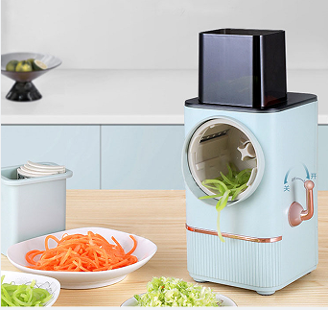
Electrical vegetable slicer
LS-17

Slide 2
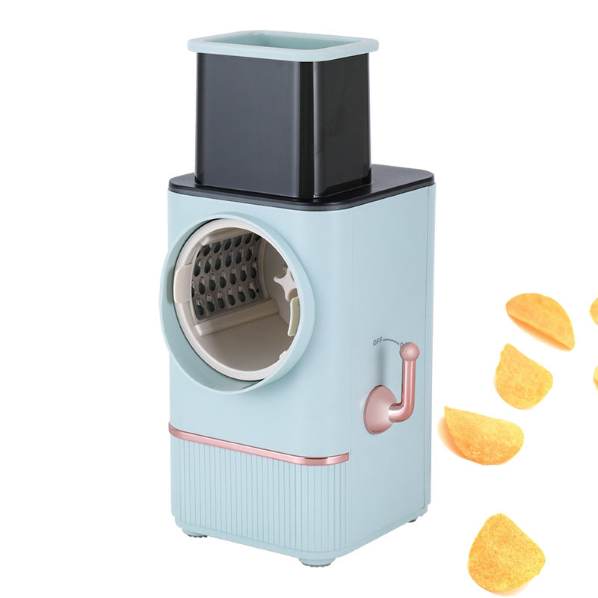
Products specifications:
*220V~50/60Hz, 95W, VDE plug
*Large size inlet
*Different sizes of grid knife are available for selection
*ON/OFF switch
*DC motor keep working around 2H

Slide 3
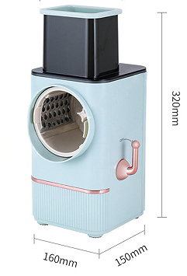
1.Product size
1. Product size: 160*150*320mm

Slide 4
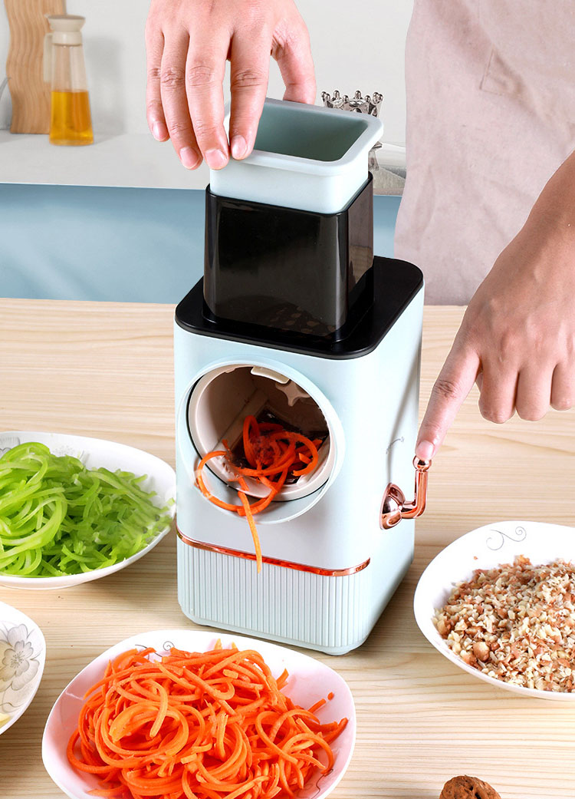
2. Easy to start(ON/OFF switch)

Slide 5
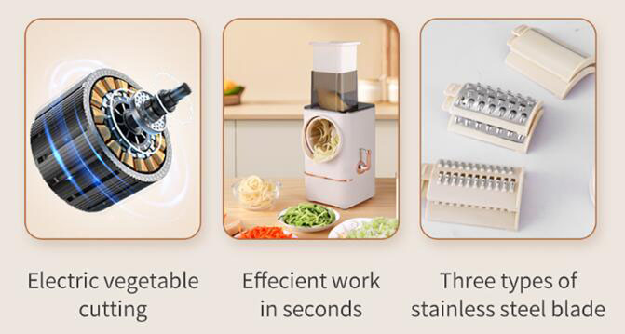
3.Motor & Blades
1. Long life using DC motor 2H
2. cutting ingredients in seconds
3. Three designs SUS blades

Slide 6
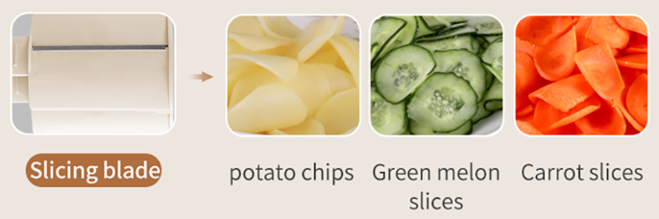
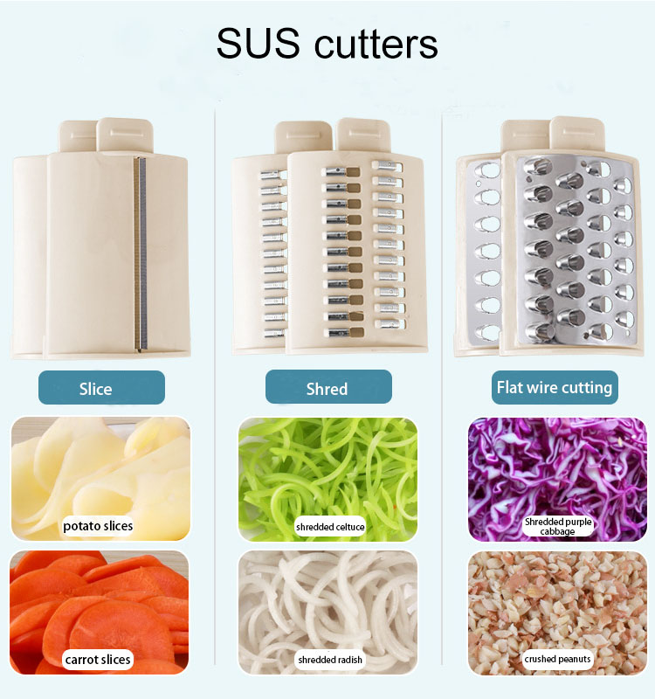
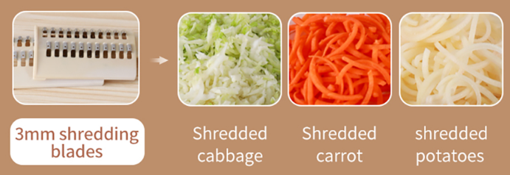
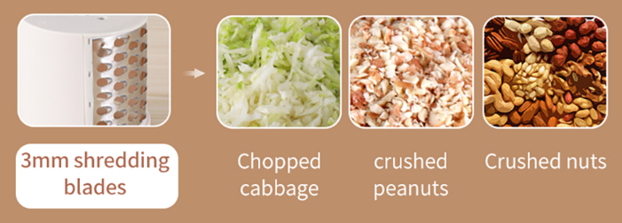
4. Blades

Slide 7
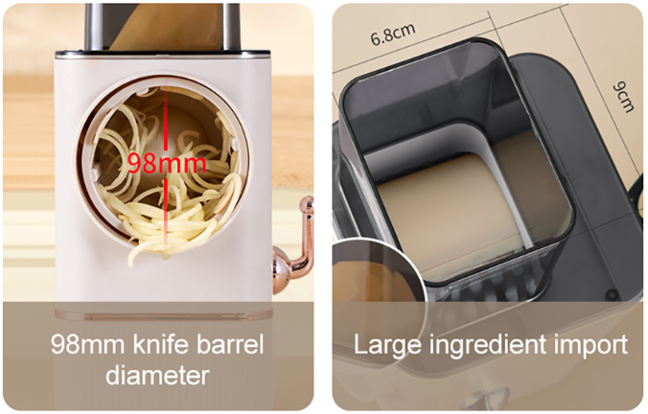
5.Product details
1. 98 MM knife barrel
2. 9*6.8CM large feeding hole

Slide 8
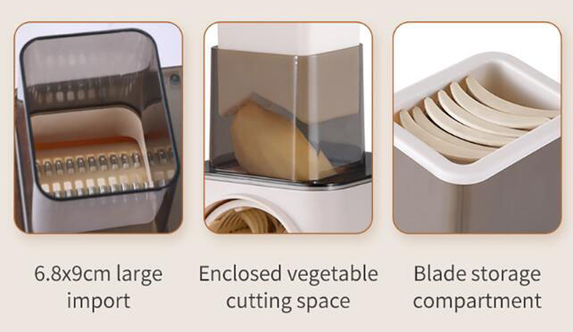
6. Advantages

Slide 9
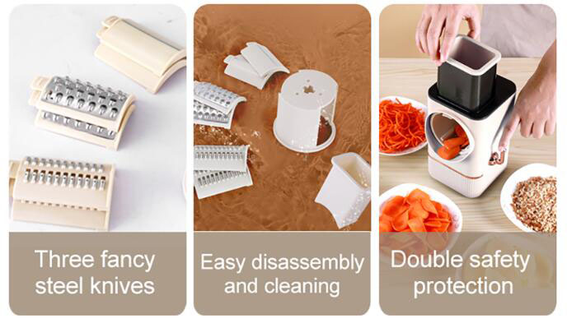
6. Advantages

Slide 10
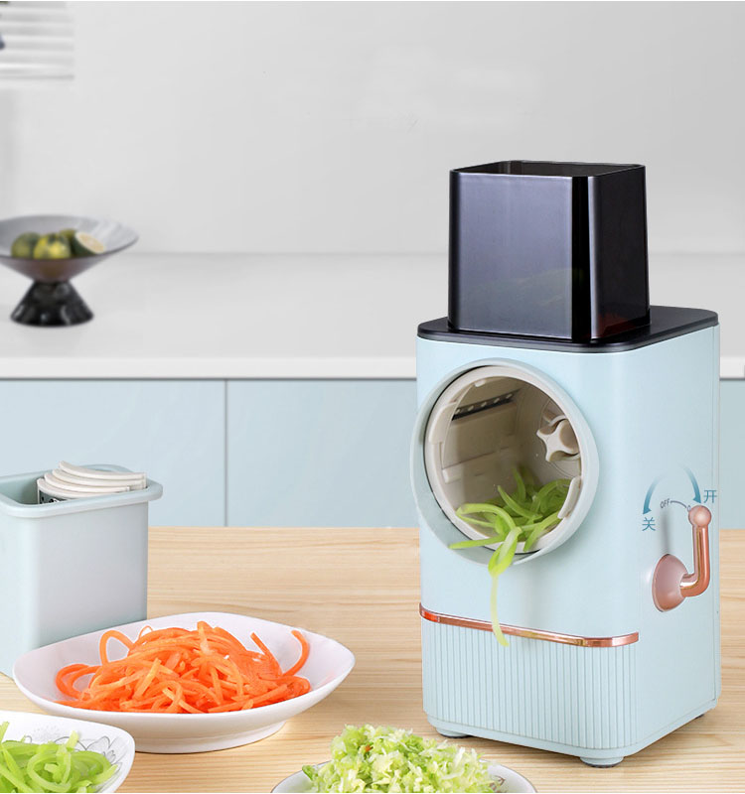

Slide 11
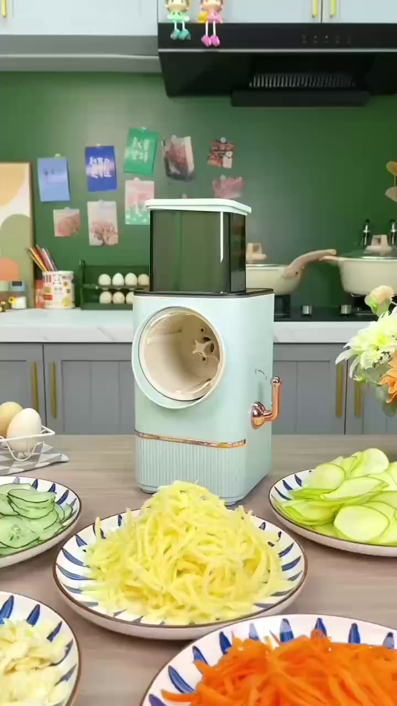
7. Product working
video
Click to enjoy video

Slide 12
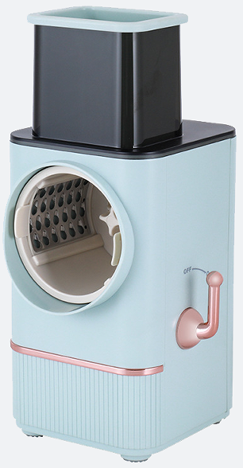
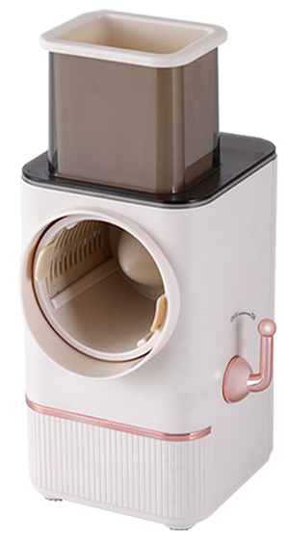
creamy white
7.Product picture in different colors
sky blue

Slide 13
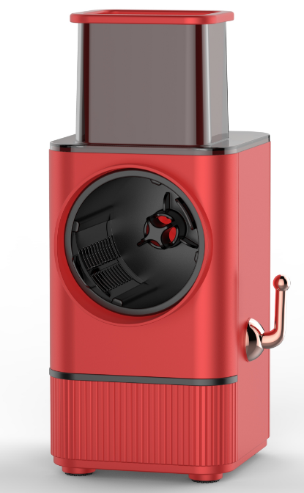
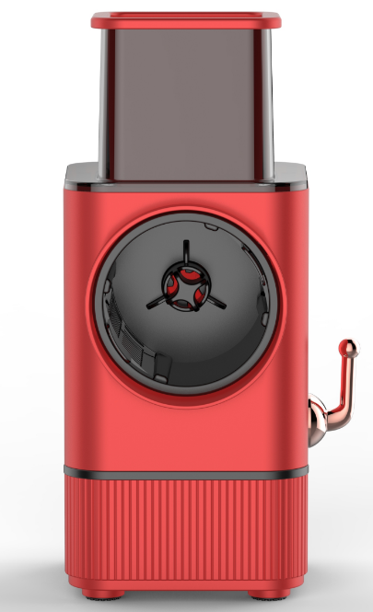
7. Product pictures in different colors

Slide 14
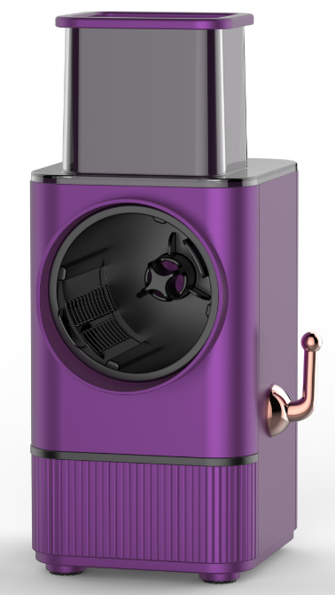
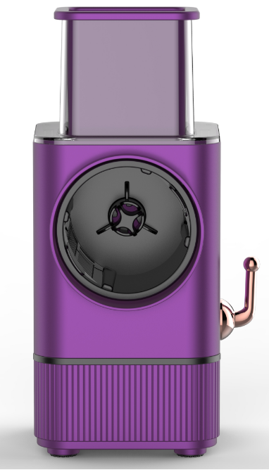
7. Product pictures in different colors

Slide 15
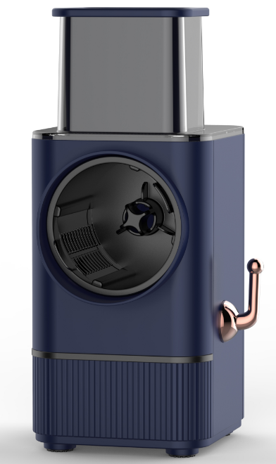
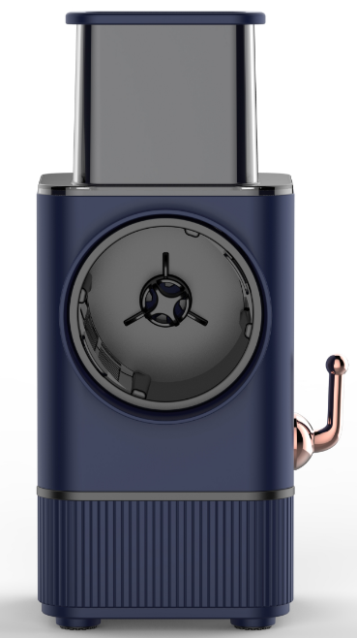
7. Product pictures in different colors

Slide 16
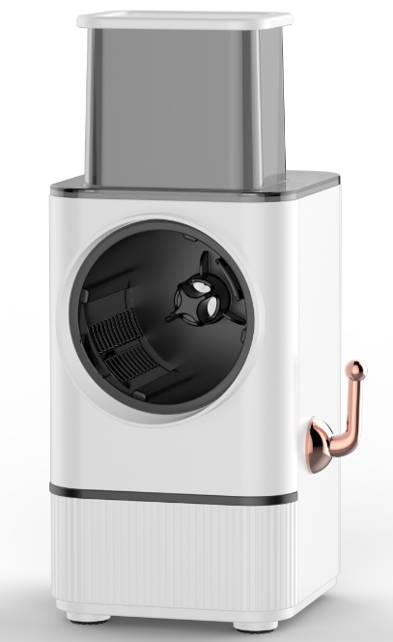
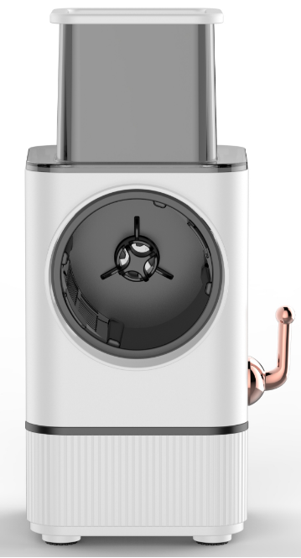
7. Product pictures in different colors

Slide 17
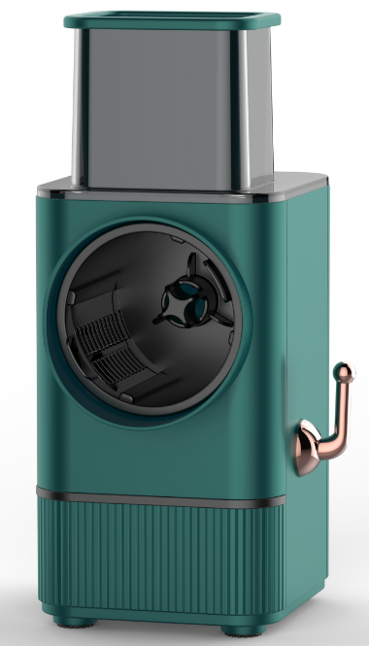
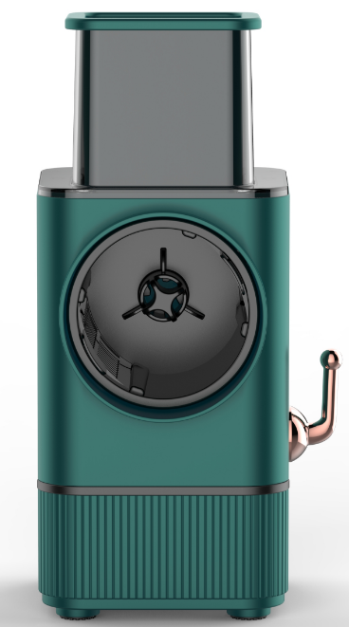
7. Product pictures in different colors

Slide 18

Thanks for watching

